Slide 1

Created By:
Matthew Pru
Buck Harris
Cody Sloan
Connor Thorpen
Notes:
Matty
Hello welcome to our presentation. I’m matty (everyone introduce)
And the project that we have been working on for this capstone is a product that we have titled PHaST Photo.

Slide 2
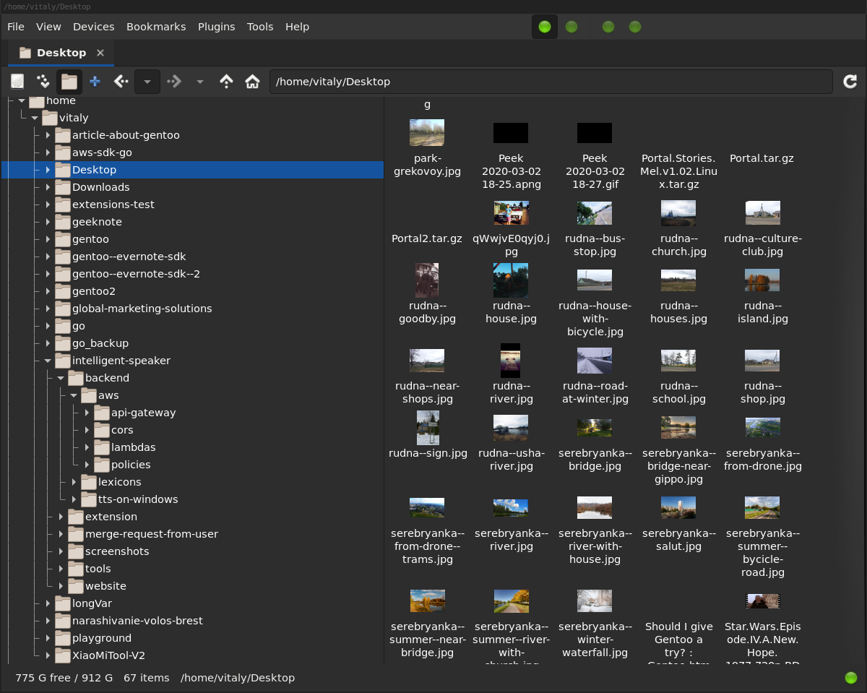
Problem to Solve
Photos take up a lot of space
Hard to find specific photos
Organizing photos efficiently can be difficult
Notes:
buck
The problem that we aimed to solve was photo management.
Most peoples photos take up a lot of space and are spread across lots of different devices.
This makes it hard and time-consuming to find the specific photo that you're looking for.
It also makes organizing groups of photos difficult and time-consuming to do by hand.
So we set out to create a product to address these issues.

Slide 3
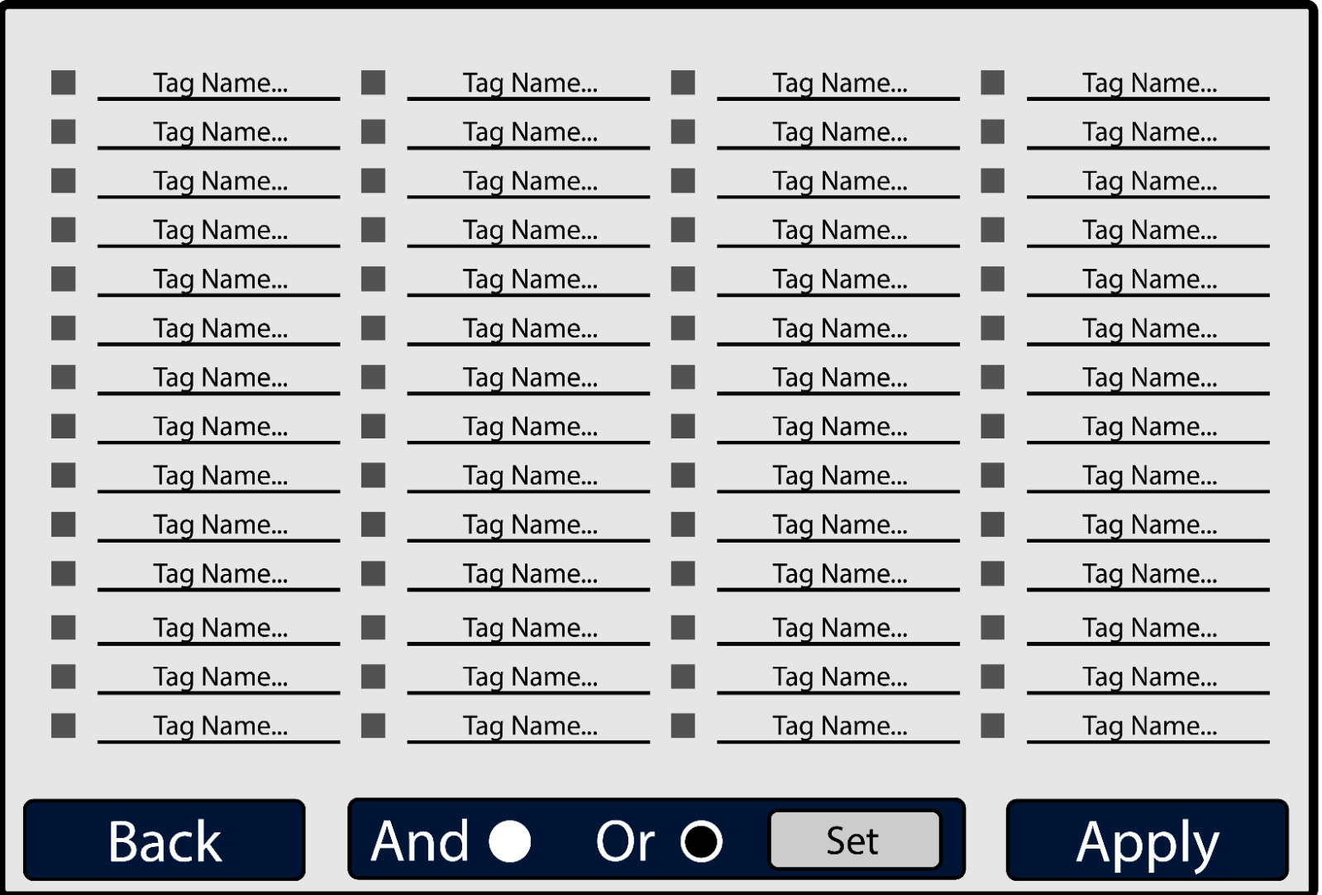
Our Idea
Build an application to help organize large collections of photos
Use a clean, interactive, and intuitive interface
Implement basic features that are expected of other photo management apps
Incorporate more advanced photo management features
Prototype for image filtering display
Notes:
Matty
Our idea to fix this issue was to build an application with the ability to reference a large group of photos, filter through them in a flexible way, and retrieve the photos that you have filtered. Our original plan was to train our own image recognition AI model, but that was deemed too tall an order for four people to accomplish over a single semester.

Slide 4
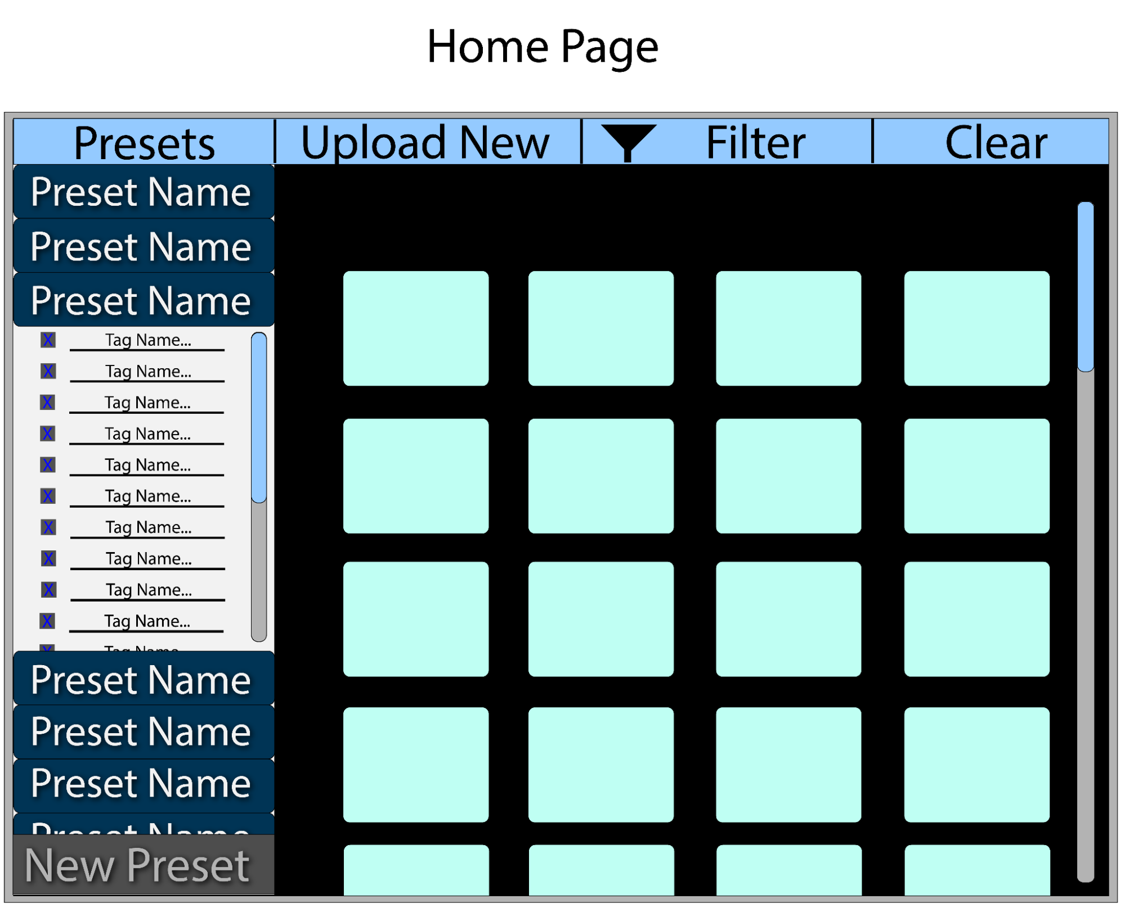
Preliminary Planning
Created a model for the app
Decided on roles for group members
Chose a technology stack
Prototype for landing page
Notes:
Connor
Before we got to work, we had to do some preliminary planning
The first thing we did was create a prototype for the landing page, shown here on the right.
Then we assigned roles for the different parts of the project, including front-end design, back-end design, database design, and filtration system design.
Finally, we chose a technology stack for our project.
We wanted our app to be simple, interactive, and intuitive, so we chose to make the front-end with react.js, which utilizes javascript, html, and css.
For our back-end, we used node.js and express.js as these tools gave us everything we needed to make a cohesive project.
And for our database, we chose to use MongoDB because we all have prior experience with it and it meets our simple storage needs

Slide 5
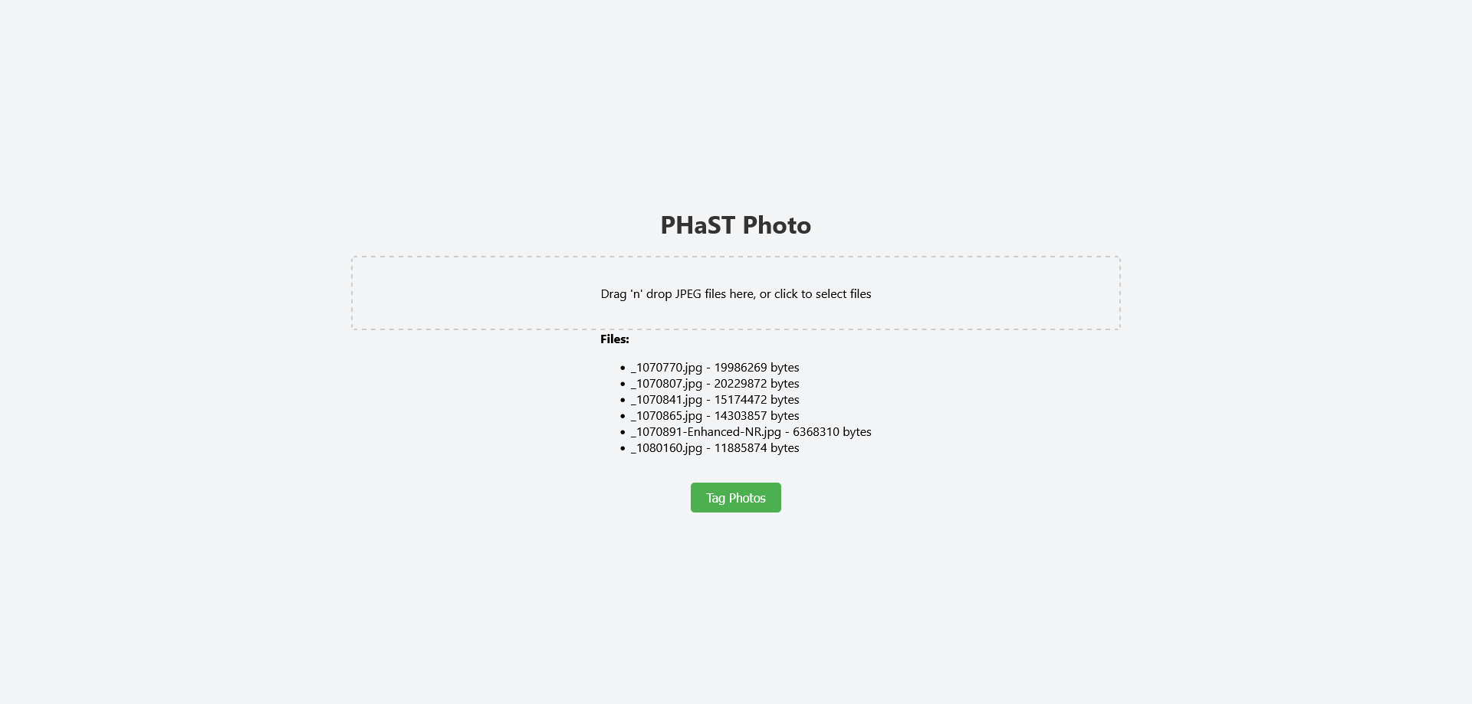
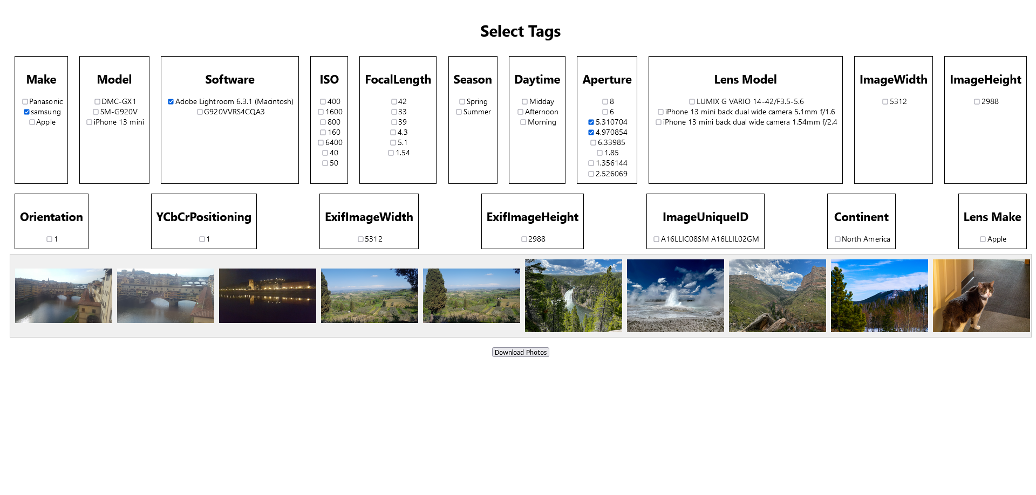
Getting to Work
We started by creating a skeleton of the project
Then we worked on adding features to the display
Early version of the home/upload page
Early version of the tag selection page
Notes:
cody So, when we started, our first version was basically just a skeleton
Didn't look like our models at all
Functionality was very basic. It only had the ability to:
upload photos
display the photos’ tags in a long, centered column that didn't look very good
Our second iteration showed improvement:
The displayed tags were now grouped and organized
The uploaded photos were also displayed at the bottom of the screen
and photos could be downloaded based on the tags that were selected
But it was still a very basic skeleton that needed improvement

Slide 6
Early Challenges
The individual roles didn’t stick for long
We lacked a sense of direction for the project
Photos were too large to store in the database.
Time management and work consistency
Notes:
Connor
We ran into several challenges early on in the development process.
First, we realized that the assigned roles were not working well. The work was not distributed evenly among members, and some of us struggled with our tasks. So, we began to collaborate more and work outside of our assigned roles.
Secondly, we realized that our project lacked a sense of direction. Some of the features we originally wanted to add were too complicated, but our project still needed something more to give it an identity and make it stand out from existing products. Speaking with our advisors and other professionals helped us get some ideas for improving our product.
Then we ran into a technical issue involving the storage of photos in our database. Uploading entire photos to our database would increase retrieval times and cause storage issues. So, we decided to only store photo paths and metadata, leaving photos to be stored locally.
Lastly, we had issues with our time management and work consistency. Because of this, our project got off to a slow start. To address this, we bagan holding weekly meetings where we could work on the project, share ideas, and help each other out.

Slide 7
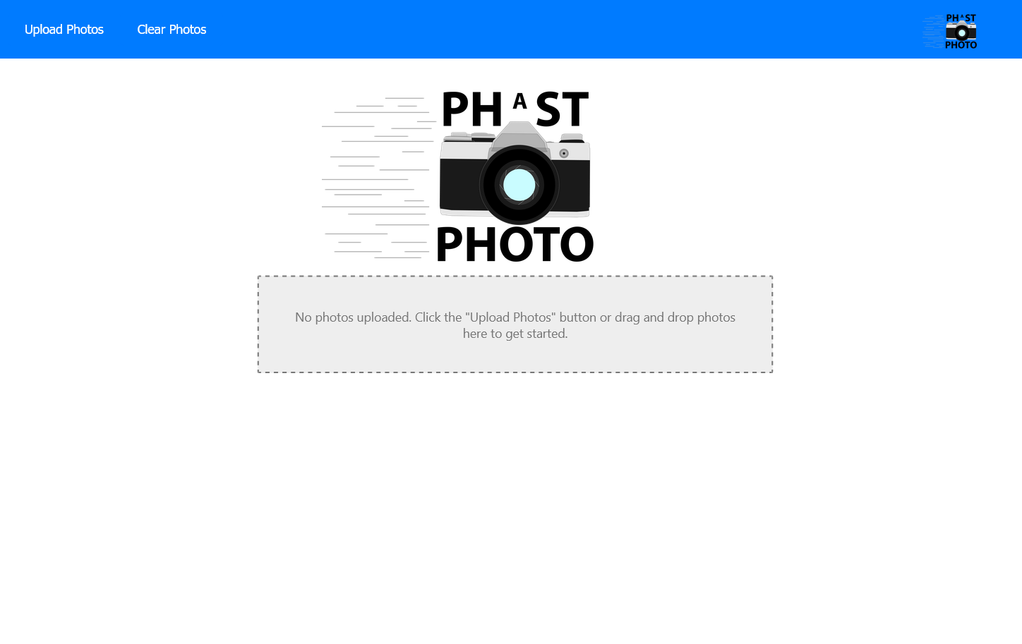
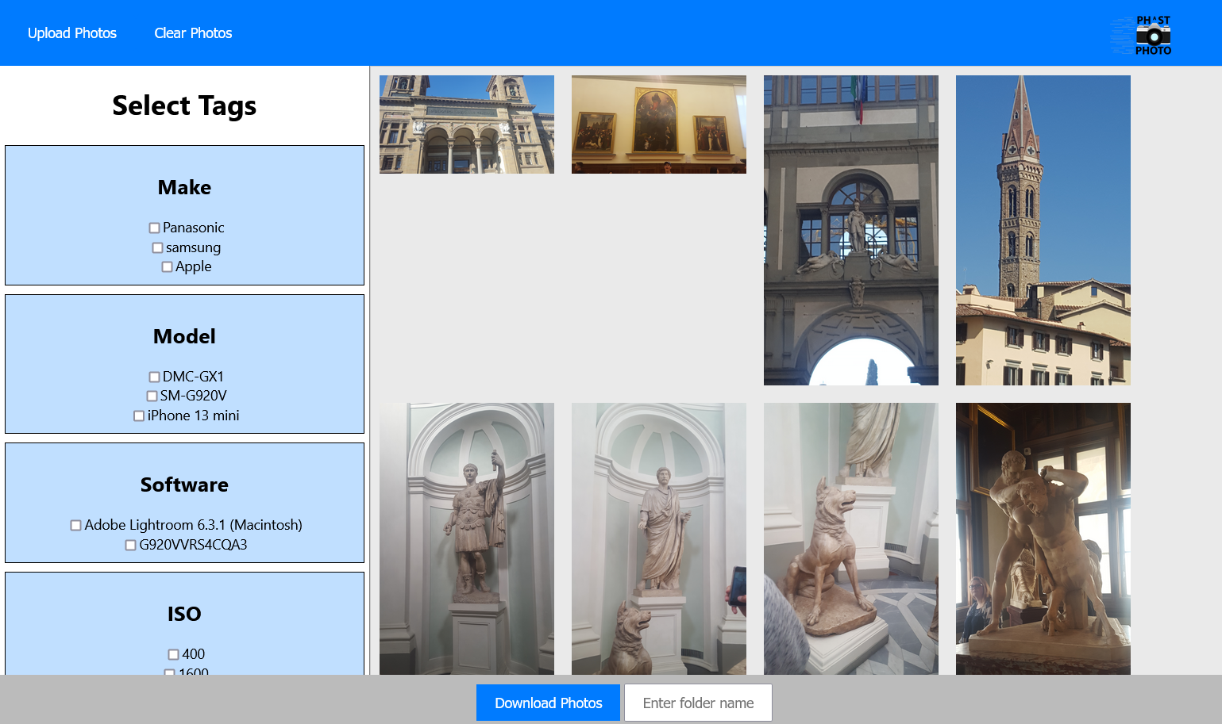
Restructuring
Restructured home/upload page
Restructured tag selection page
Notes:
cody
It was clear that our web app needed to be reworked
The skeleton was very bland and boring
And the tags took up most of the page.
So we redesigned the entire User Interface:
The new version looked much more like our original models
It was much cleaner and easier to look at
The redesign started to look like an actual product, which gave us encouragement
We also added more functionality to the redesign, including the abilities to:
Clear the uploaded photos
Upload different photos
and give a name to the download folder, if desired.

Slide 8
Architecture
Front-end
Back-end
Home/Upload Page
Uploaded Photos
Extract & Clean Metadata
ChatGPT Plugin
Reupload
Clear
Photo Paths/Tags
Photo Paths/Tags
.zip file of filtered photos
Download
Tag Selection Page
Database
Notes:
buck
Here is an overview of our project’s architecture.
The user starts on the home/upload page, selects a collection of photos, and clicks the upload button.
These photos are sent to the backend, where we extract the metadata using the exif-parser javascript library, clean it, and turn it into tags.
These tags include: time and date, camera and location information, and other pieces of information captured at the time of taking the photo.
Here, we also utilize the ChatGPT API to generate more complex tags based on the content of the photo.
Note that other plug-ins could be added to generate a wider variety of tags.
The photo paths, along with the associated tags, are then stored in the database where they can be retrieved and sent to the front-end tag selection page.
From this page users can filter photos based on the provided tags and then download them.

Slide 9
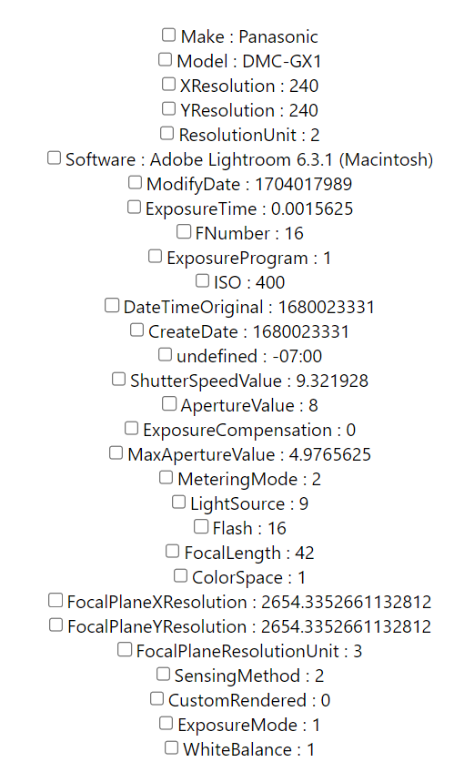
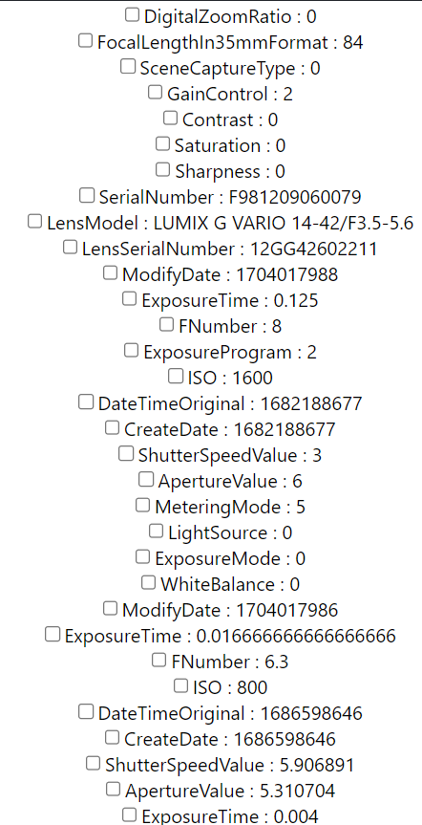
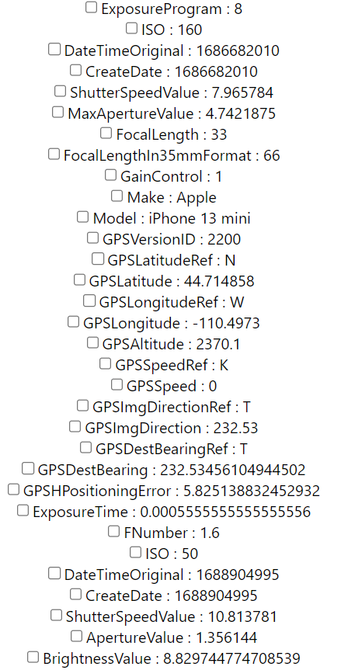
Custom Logic and Extraneous Tags
Notes:
Matty
As far as the metadata, we originally made everything available to users without combing through it at all. We reasoned that there was a lot of extraneous data, so things like GPSSpeed, Brightness Value, and exposure program. We decided these were not things that the average user would even understand and the advanced user would likely never use to search for a photo. Therefore we processed all data before including it in our list of tags and ignored everything that we deemed unuseful. This is hardcoded and would require constant updating, as every camera manufacturer has its own set of native details that they write to their photo files. We also found that a lot of the data had potential to be useful but was stored in a strange format. This means we needed to read it in and think about how it worked, and then convert it to real useful tag categories. An example is that date and time were stored in milliseconds from the epoch, something that the average user cannot utilize to filter through their collections. We read that in and processed it through several custom functions to output our own tags which would allow users to filter via time of day, so morning, afternoon, evening and such, as well as seasons of the year.

Slide 10
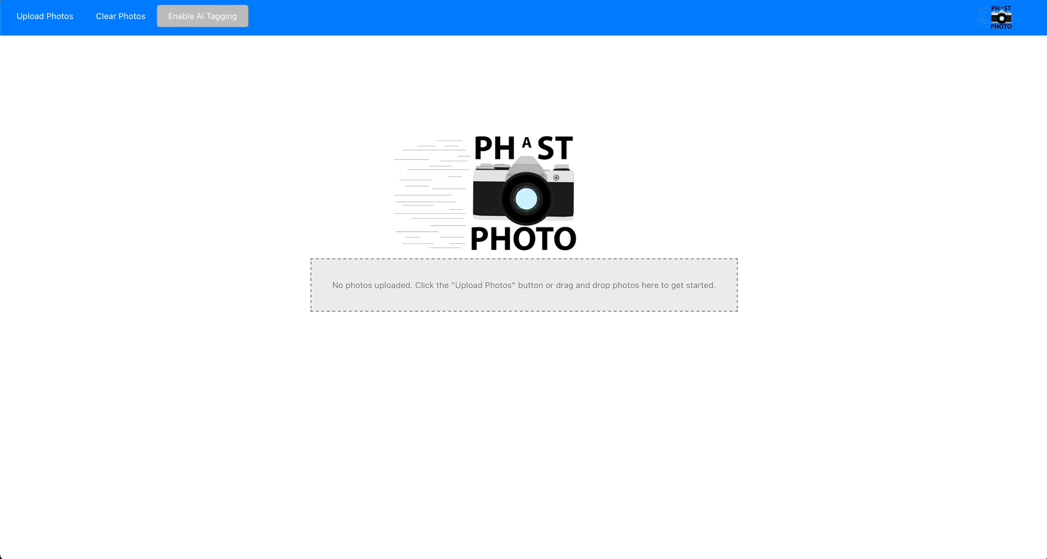
Artificial Intelligence
Notes:
buck
One major thing that set us apart is our use of artificial intelligence.
Since all of our tags are coming from data written to the photos by the camera taking them, we wanted to include tags based on what was actually in the photos.
Chat GPT 4 vision API allows us to implement this functionality
To keep tags consistent across many photos, we gave Chat GPT a list of tags to choose from.
This serves as a constraint on the actual tags that Chat GPT can apply so that we do not get an influx of tags that only apply to a single photo.
The service cost money, however, so in the future, we planned to position this as a premium feature that our users would need to subscribe to.

Slide 11
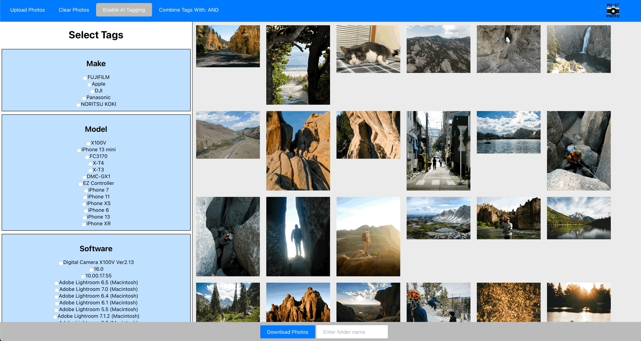
Live Updates
Notes:
Matty
After getting the core functionality of our product up and running we turned to some UI factors that would enhance the experience of using our product.
A later feature that we included was the ability to see in real time what the tag selection was actually doing. When we started, we were constantly displaying every photo that was uploaded.
We decided that after the initial upload, that this wasn’t really much of a feature and noticed that we were already keeping track of all selected tags to display them on the left.
We decided to use this list to query our database and retrieve the paths of photos whose tags were associated with that list.
This resulted in us being able to constantly update our display on the right so that users could actually see what they would be downloading with a certain tag combination so that they could more accurately refine their search.

Slide 12

Boolean Search Parameters
Notes:
Cody
Another feature that we implemented to enhance user experience was expanding the ways in which tags could be combined.
Originally, the photos that were displayed and downloaded were based off of an AND boolean query in the database:
For example, selecting the Apple make and 100 ISO tags would only show photos that were captured on an iphone with an ISO of 100
This was an okay start, but didn’t offer much flexibility
We changed it so users can search photos using AND or OR Boolean Searches
So, with the OR query, you could select many different tags and be given every photo that has at least one of those tags.
We are planning to expand this even further to allow for searches like "Apple and ISO 100" OR "Panasonic and ISO 400", for example.

Slide 13
What’s Next?
Login management system
Persistent photo storage
Ability to process more file types
Manually select a photo and add a tag to it
Cloud storage
Notes:
Matty
As this capstone comes to a close, we wanted to think about what we could add if we were to continue development. For an actual product, we would surely need a login management system so that we can secure and differentiate photo collections between different users.
We have also not yet perfected persistent storage. Currently, users must upload a group of photos every time they use the product. Especially in the case of users utilizing the ai tagging feature, the lack of persistent storage makes our product less time efficient. We would like to accomplish a persistent storage system so that a user can open the product and past uploads would already be present with the tags already applied to them, which would save on processing time for the application.
We would also like to expand the set of file types that we can process as we are currently only doing operations with jpeg files.
We also want the functionality to add tags manually to a single or group of photos for a more bespoke user experience.
our current product still requires local storage of a photo but we thought it would be useful to include a cloud storage feature for premium users (those users utilizing ai tagging).

Slide 14
Thank
You

